Slide 1

Learning & Memory
Chad Williams
University of Victoria

Slide 2
Lecture Outline
Learning
Working Memory
Long-Term Memory
Memory Storage

Slide 3
Lecture Outline
Learning
Working Memory
Long-Term Memory
Memory Storage

Slide 4

Learning and Memory
Learning: The process of acquiring new information
Memory: The ability to store and retrieve learned information

Slide 5
Learning
Explicit Learning: Acquires knowledge through instruction, practice, and feedback
Intentional and conscious
Includes the learning of rules and strategies
Results in declarative memories
Implicit Learning: Acquires knowledge through associations
Unintentional and subconscious
Includes repeated exposure of pairings
Results in nondeclarative memories

Slide 6
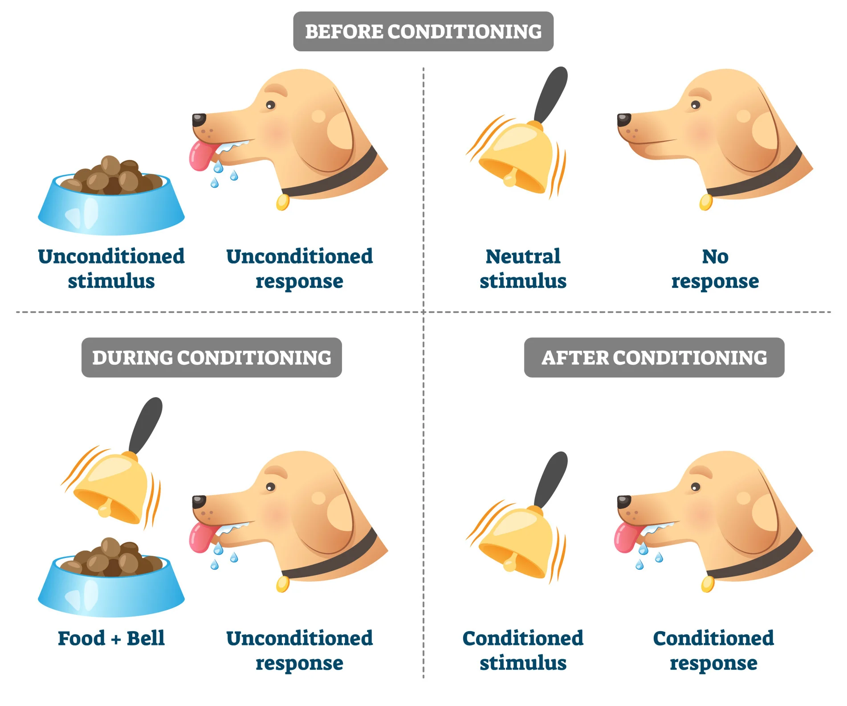
Learning
Classical Conditioning: Implicit learning by associating stimuli
Conditioning: Learning Process when two stimuli are repeatedly paired together
Unconditioned Stimulus (US): A stimulus that has no learned associations but has an unconditioned response (UR)
Food for a dog elicits a saliva response
Neutral Stimulus (NS): A stimulus that has no learned associations and no response
Ringing a bell for a dog elicits no response
Conditioned Stimulus (CS): A NS that has a learned association with a US
It acquires the UR from the US, which is now called a conditioned response (CR)
After conditioning, a bell will elicit a saliva response
The bell now predicts food

Slide 7
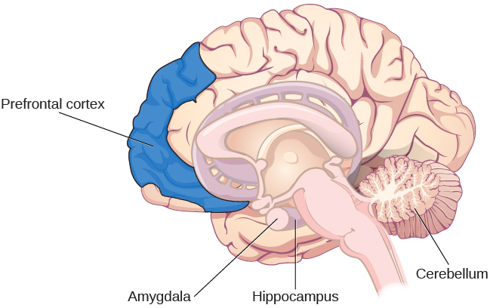
Learning
Classical Conditioning Processes
Cerebellum: Coordinates learned motor responses
Brainstem: Connects conditioned stimulus with motor and autonomic responses
Hippocampus: Encodes context and relationships between stimuli
Amygdala: Links neutral stimuli with emotional and fear responses
Prefrontal Cortex: Regulates attention and expectations during learning
Brainstem

Slide 8
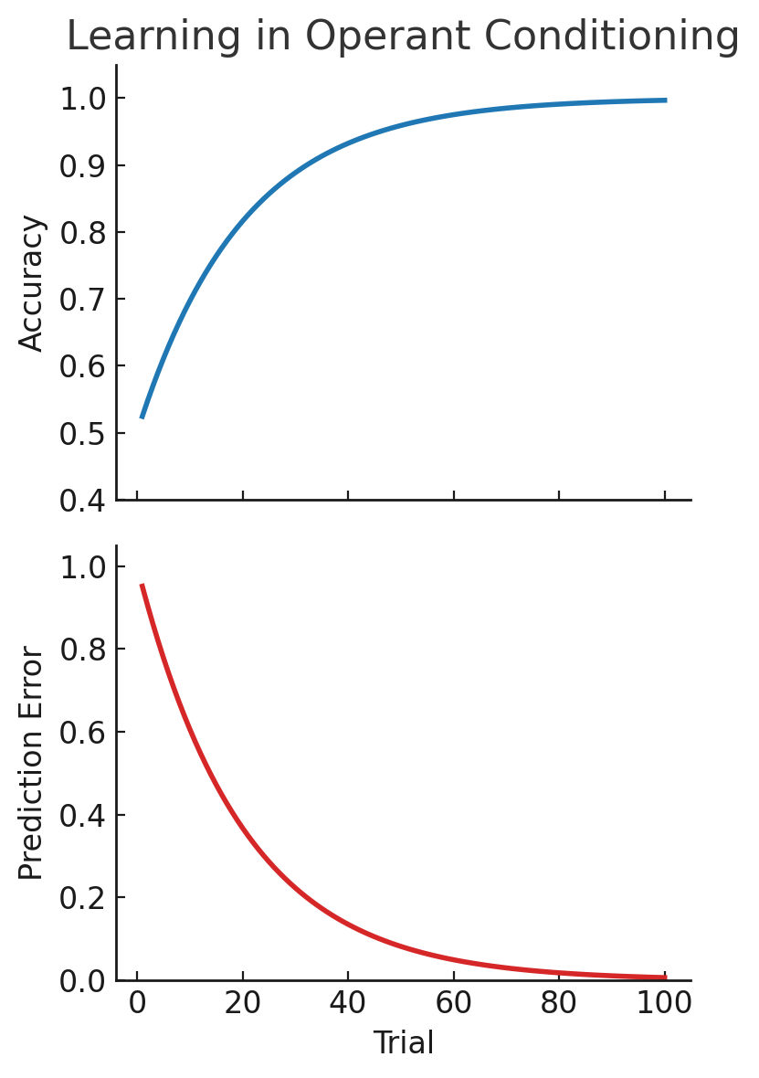
Learning
Operant Conditioning: Implicit learning through trial-and-error
Learning to expect the proper consequence of our action

Slide 9
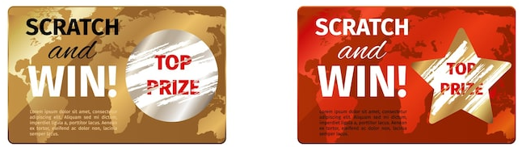
Learning
PLEASE TRY AGAIN!
WINNER!
Gold Ticket
Red Ticket

Slide 10
Learning
PLEASE TRY AGAIN!
WINNER!
Gold Ticket
Red Ticket

Slide 11
Learning
Operant Conditioning: Implicit learning through trial-and-error
Learning to expect the proper consequence of our action
E.g., If I leave at 8:00AM, I should make my 8:30AM class
Prediction Error: When our expectation does not match the actual outcome
E.g., I left at 8:00AM, but made it to class at 8:45AM
Prediction error: 15 minutes late
Over many repetitions, we learn to properly predict our actions
E.g., I must leave at 7:45AM to make my 8:30AM class

Slide 12
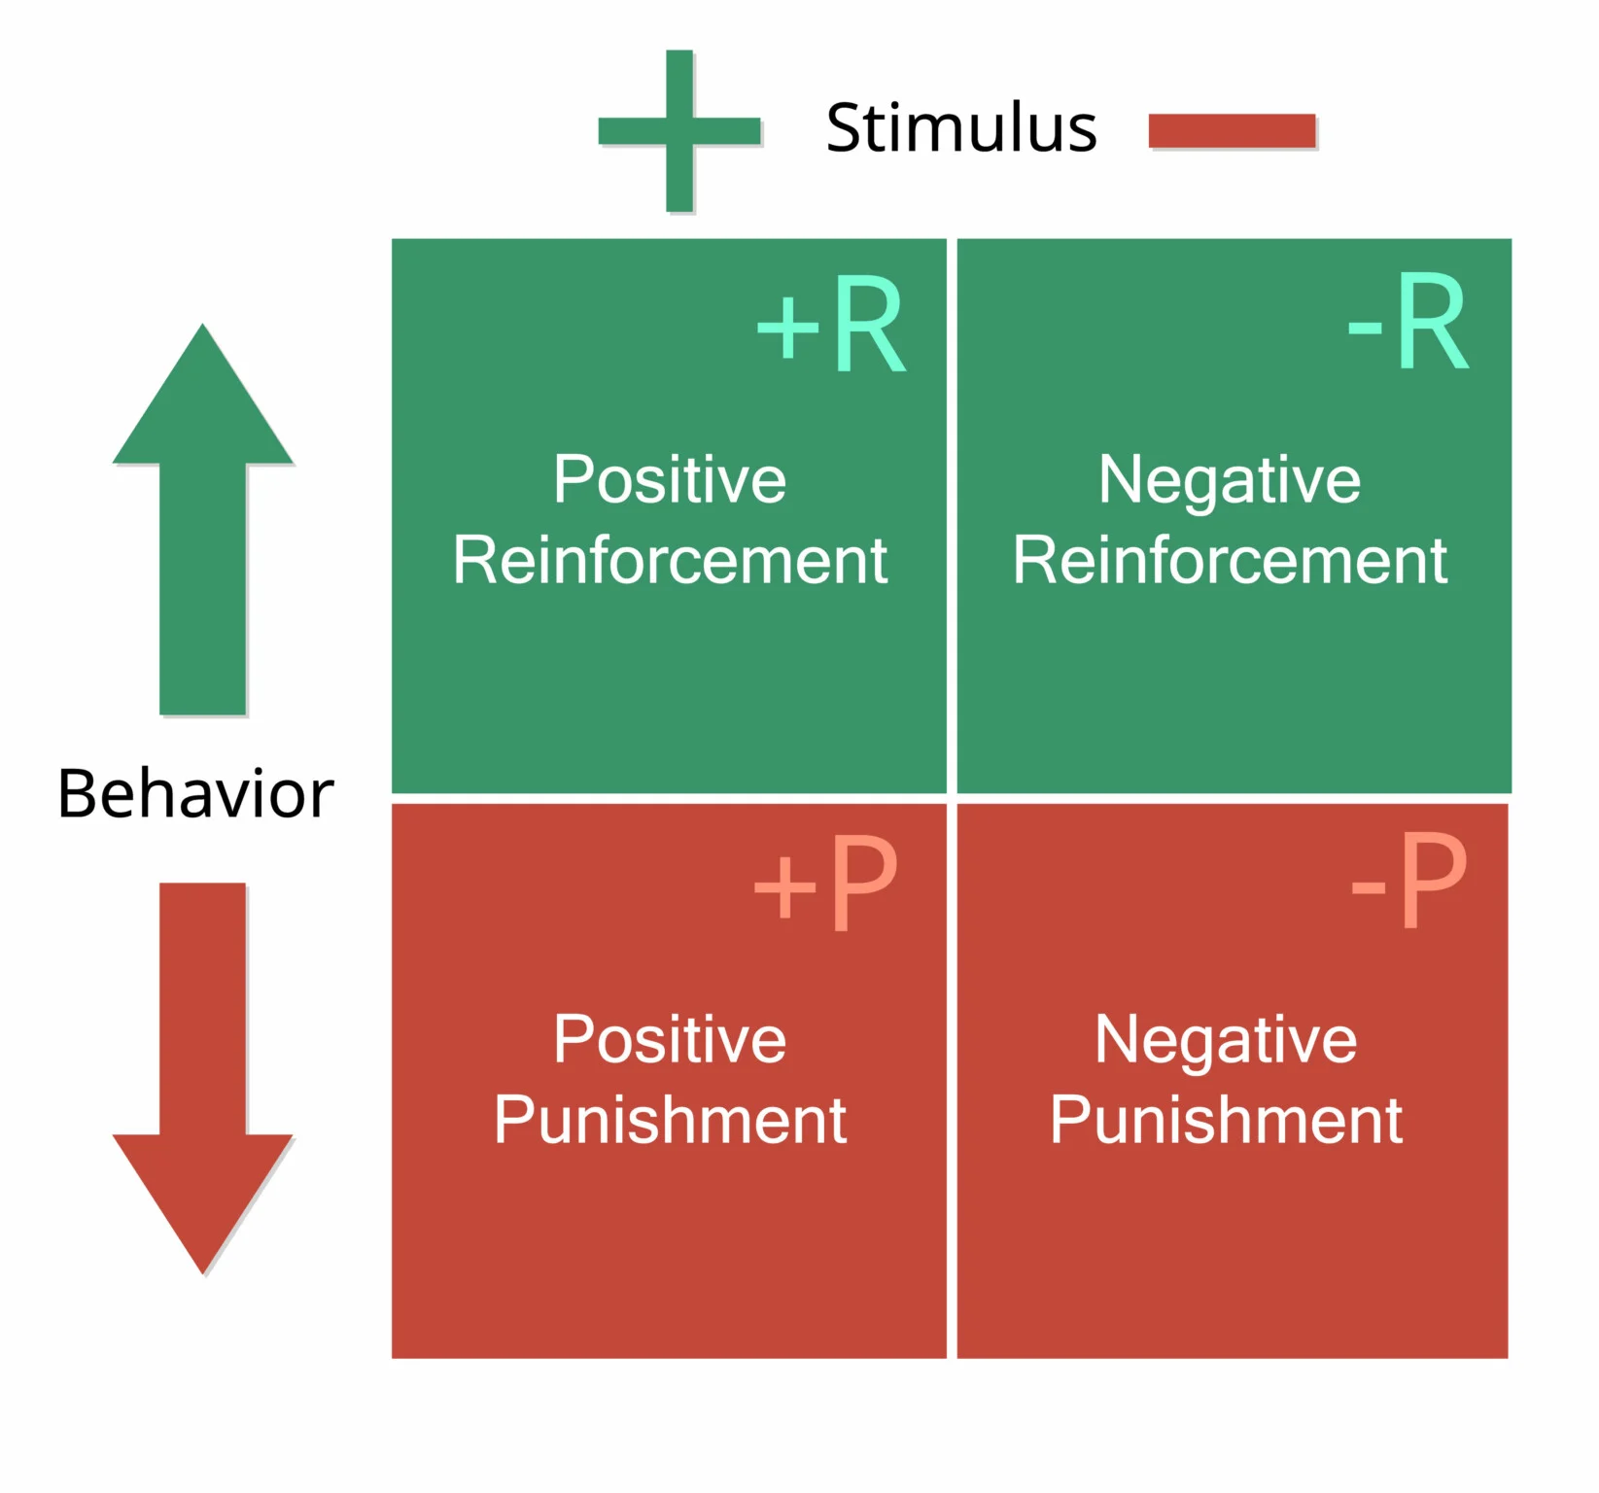
Learning
Operant Conditioning
Behavioural Change
Reinforcement: Increasing a behaviour
Punishment: Decreasing a behaviour
Stimulus Type
Positive: Addition of a stimulus
Negative: Removal of a stimulus

Slide 13
Learning
Operant Conditioning
Positive Reinforcement: Increasing a behaviour by giving a stimulus
Praising a student for submitting their work
Negative Reinforcement: Increasing a behaviour by removing a stimulus
Putting your seatbelt on in response to the seatbelt alarm beeping

Slide 14
Learning
Operant Conditioning
Positive Punishment: Decreasing a behaviour by giving a stimulus
Getting a speeding ticket after driving too fast
Negative Punishment: Decreasing a behaviour by removing a stimulus
A player gets benched for unsportsmanlike conduct

Slide 15
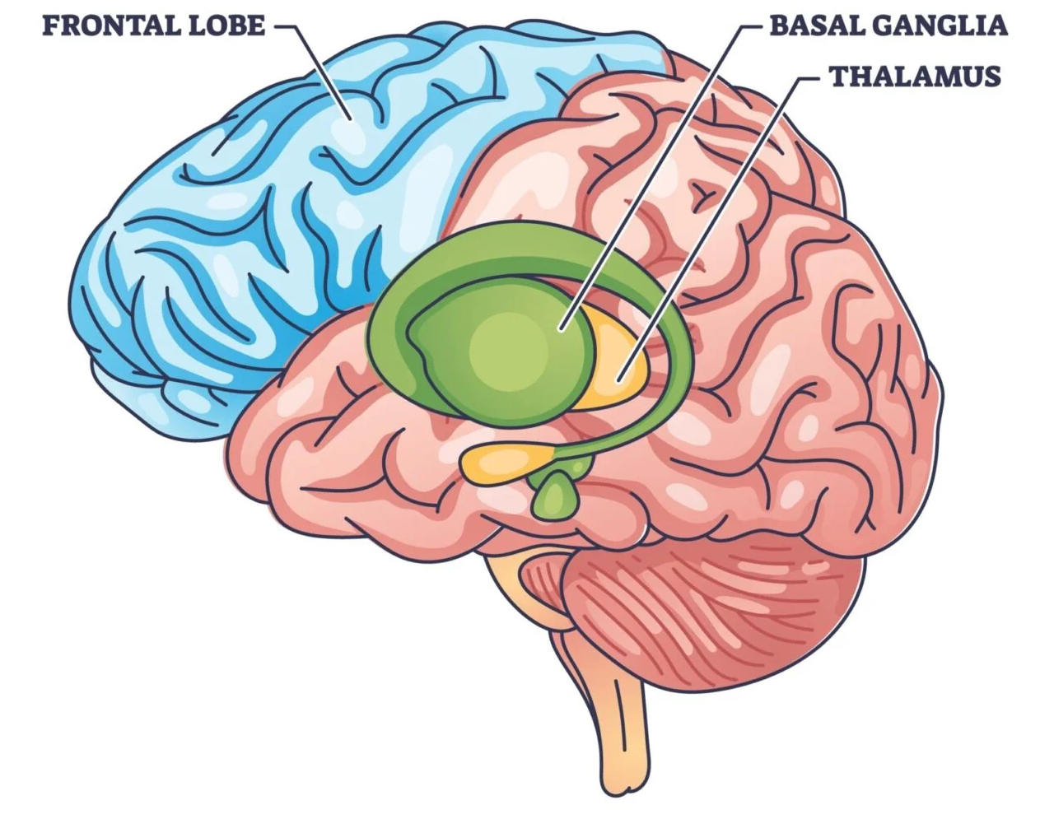
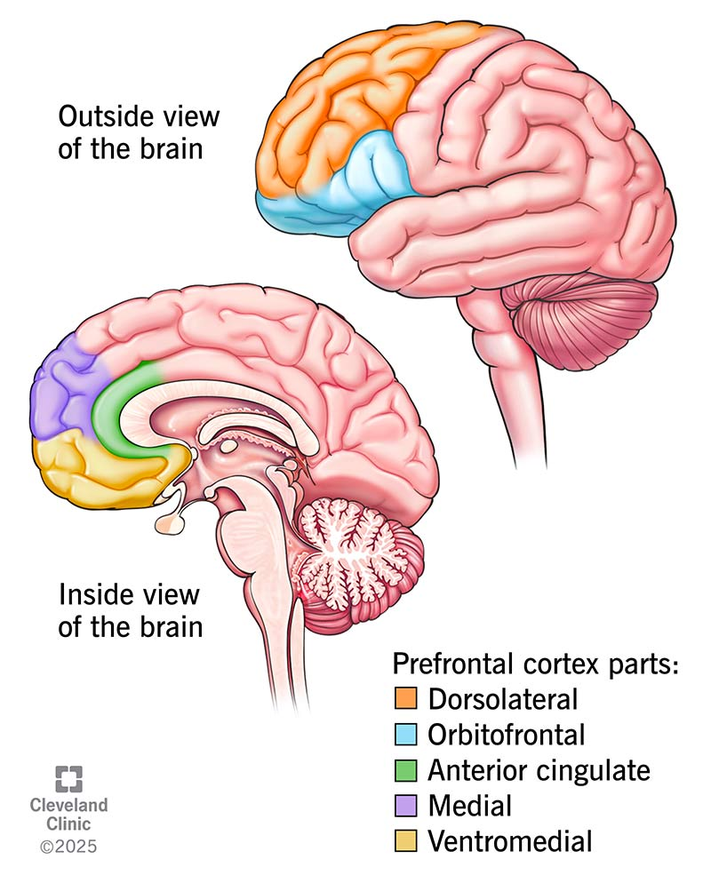
Learning
Operant Conditioning Processes
Mesolimbic Dopamine Pathway: Computes and projects prediction errors to drive learning
Ventral Tegmental Area (VTA) → Nucleus Accumbens (NAcc)
Mesocortical Dopamine Pathway: Modulates cognitive control, working memory, and goal-directed behaviour
Ventral Tegmental Area (VTA) → Prefrontal cortex (PFC)
Interaction of the Dopamine Pathways
The VTA receives feedback from both the NAcc and PFC
The pathways interact by modifying VTA activity

Slide 16
Learning
Operant Conditioning Processes
Nucleus Accumbens
Reinforces actions that lead to desirable outcomes and avoids undesirable outcomes
Updates expectations based on prediction error signals
Prefrontal Cortex
Anterior Cingulate Cortex: Monitors prediction errors to adjust behaviour
Dorsolateral PFC: Maintains rules and goals to guide action selection
Orbitofrontal Cortex: Represents the value of an expected action

Slide 17
Lecture Outline
Learning
Working Memory
Long-Term Memory
Memory Storage

Slide 18
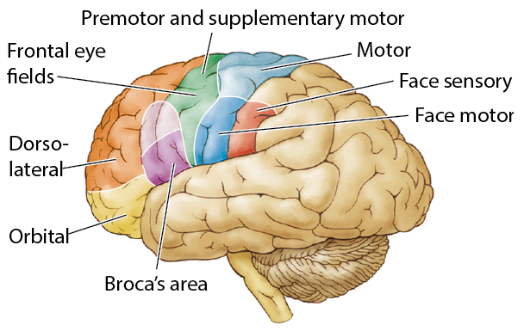
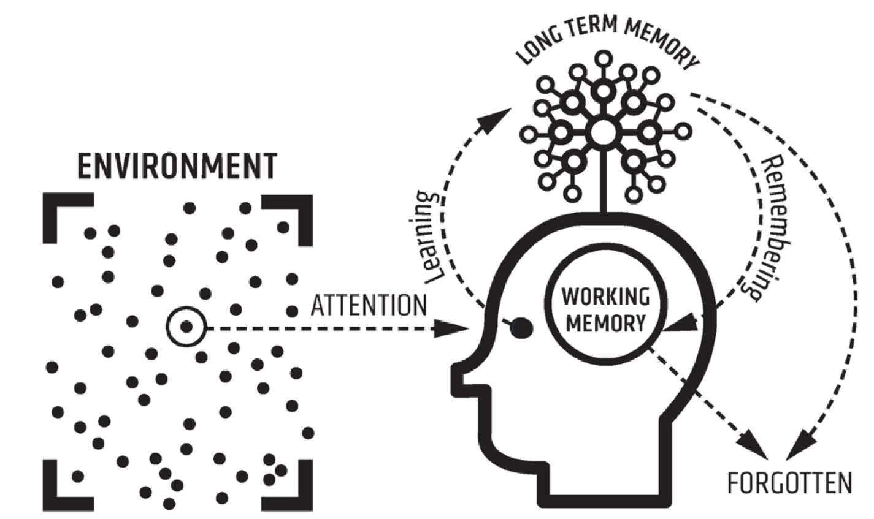
Working Memory
Working Memory: Capacity to temporarily store and manipulate limited information
Maintained for seconds without active rehearsal
Limited capacity, though the exact limit is debated
Miller (1956): 7±2 items
Item: Single elementary unit (2-5-0-5-5-5-1-2-3-4)
Cowan (2001): 3-4 chunks
Chunk: A grouping of elementary units (e.g., 250-555-1234)
Capacity is significantly expanded when integrating long-term memory mechanisms
E.g., a chess expert will chunk an entire board and all its pieces rather than each piece individually
What counts as an item is also debated
E.g., 2x4 holds the items 2, 4, and multiplication
However, the goal of multiplication may also be considered an item

Slide 19
Working Memory
Dorsolateral PFC (dlPFC)
Region thought to represent working memory
Receives dopamine inputs from the mesocortical dopamine pathway
Increased activity correlated with the number of items being held
Increased activity correlated with the complexity of manipulation
E.g., simple math versus an anagram
2 + 2
Listen = Silent, Enlist, Tinsel, Inlets

Slide 20
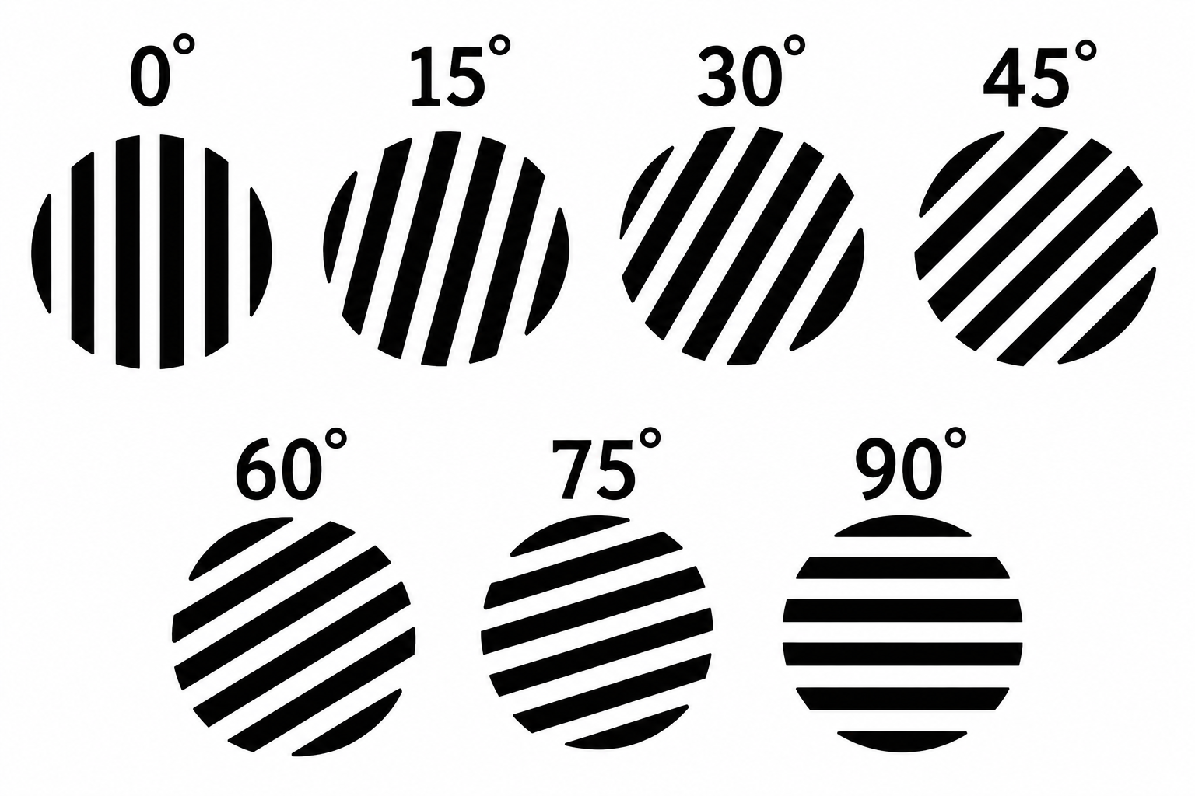
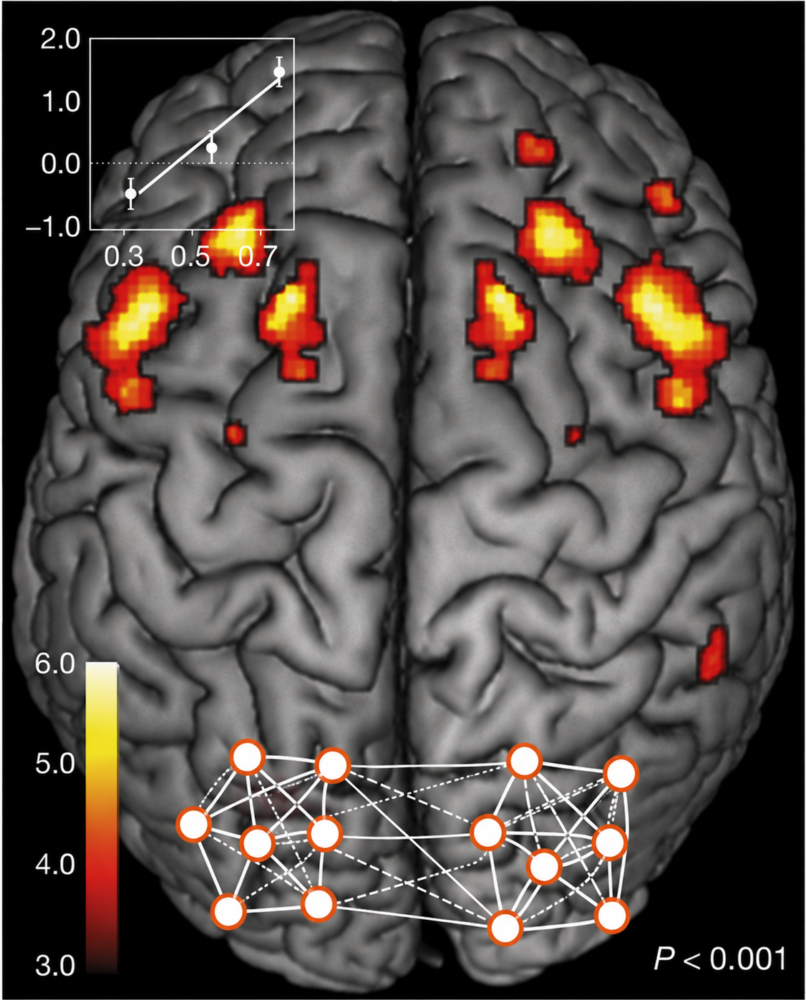
Working Memory
Harrison & Tong (2009)
Research Question: Does elevated dlPFC activity during the delay period reflect the storage of working memory content?
Methods: Humans were shown oriented gratings, waited a delay period, and were to report whether a new stimulus matched the remembered stimulus
IV: Which orientation was being remembered
DV: fMRI activity in the dlPFC and V1
Used MVPA (machine learning) to detect patterns within brain regions, rather than simply more or less activity

Slide 21
Working Memory
Harrison & Tong (2009)
Results
fMRI: Increased neural activity in dlPFC but not V1 during delay period
MVPA: Patterns corresponding to orientation in V1 but not dlPFC during delay period
Conclusion: dlPFC does not reflect the storage of WM content
Instead, WM content is represented in sensory regions (V1)
dlPFC represents the top-down activation of these sensory regions

Slide 22
Lecture Outline
Learning
Working Memory
Long-Term Memory
Memory Storage

Slide 23
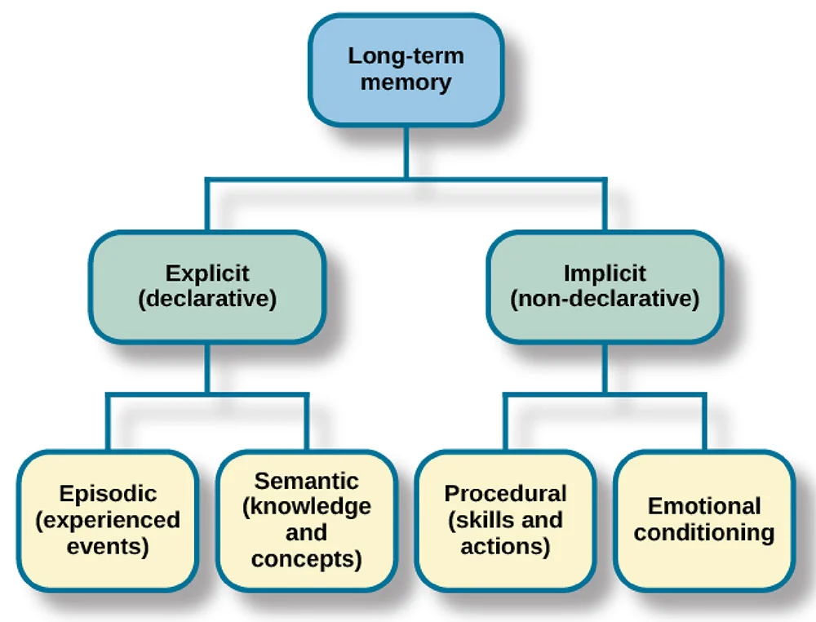
Long-Term Memory
Long-Term Memory (LTM): Capacity to store information and experiences for extended periods of time
Lasts hours to lifetime
Involves familiarity and recollection
LTM Processes:
Encoding: Process of transforming information into a memory trace
Retrieval: Process of retrieving facts and events from memory
Storage: Process of retaining and preserving information

Slide 24
Long-Term Memory
Types of Long-Term Memory
Declarative/Explicit Memory: Conscious recollection of facts and events
Able to describe
Episodic Memory: Memory of events and personal experiences
Specific to a context (e.g., time and place)
Semantic Memory: Memory of general knowledge, concepts, facts, and meanings
Not specific to a context

Slide 25
Long-Term Memory
Types of Long-Term Memory
Nondeclarative/Implicit memory: Subconscious knowledge of perceptual and motor procedures
Demonstrate through performance
Procedural Memory: Memory for motor skills, habits, and actions
E.g., how to swing a bat
Emotional Memory: Memory for an emotional response to a triggering stimuli
E.g., PTSD

Slide 26
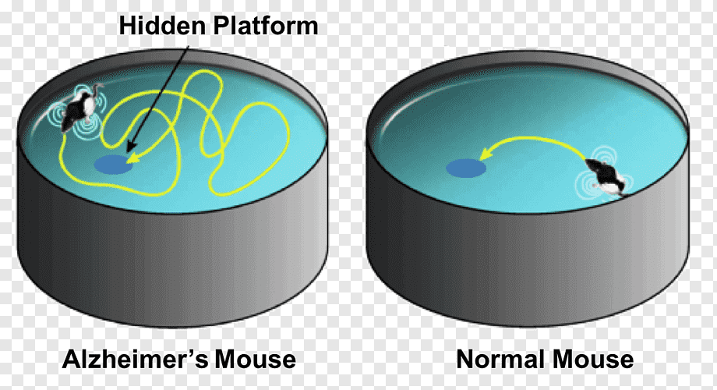
Long-Term Memory
Morris, 1982
Research Question: Does the hippocampus code memory for spatial locations?
Methods: Morris Water Maze. There are environmental cues of the room (windows, door) and there exists an invisible platform the rats are to reach
Rats are dropped at different spots of the tank, and thus use environmental cues to orientate themselves
IV: Rats are lesioned or not in the hippocampus
Also, same or novel starting location on each trial
DV: Time to platform after learning

Slide 27
Long-Term Memory
Morris, 1982
Results
Non-lesioned rats quick to find platform by using environmental cues
When placed at same or novel starting location each trial
Lesioned rats slow at finding platform and explore randomly until found
Able to find platform when placed at same starting location each trial
Conclusion: Hippocampus creates a spatial map of the environment

Slide 28
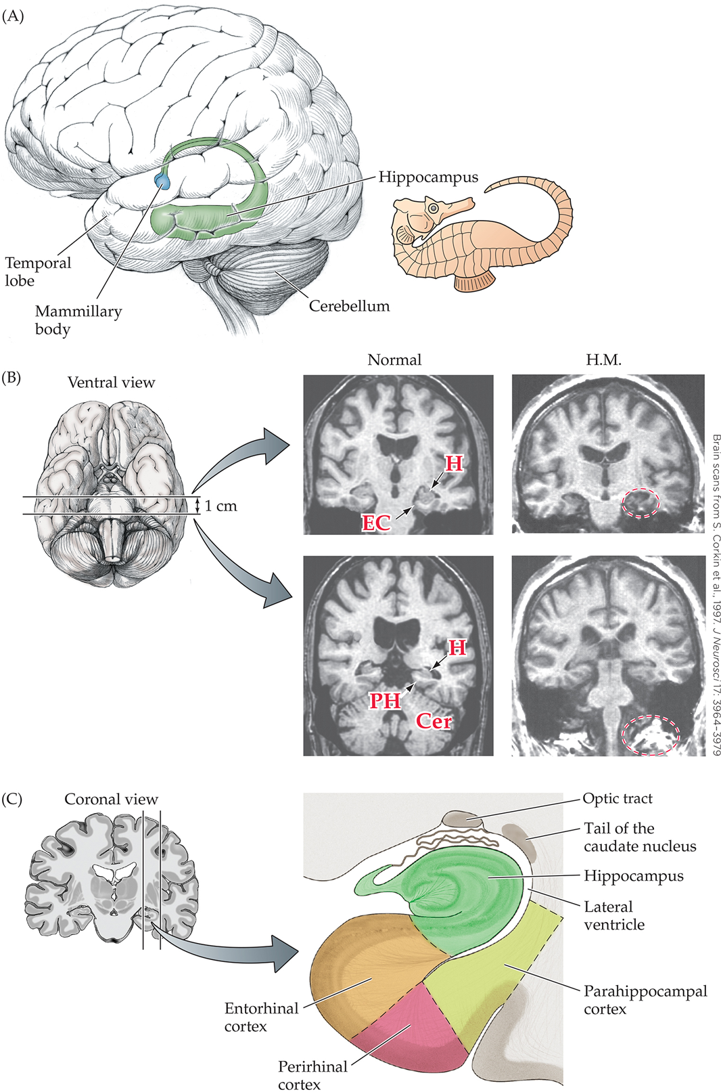
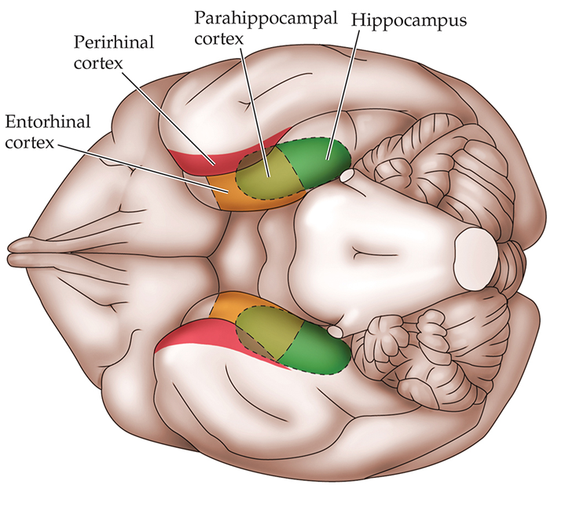
Long-Term Memory
Declarative Memory Processes:
Hippocampus: Encoding and retrieval of memory
Perirhinal Cortex: Sense of familiarity in memory
Parahippocampal Cortex: Processing of memory context

Slide 29
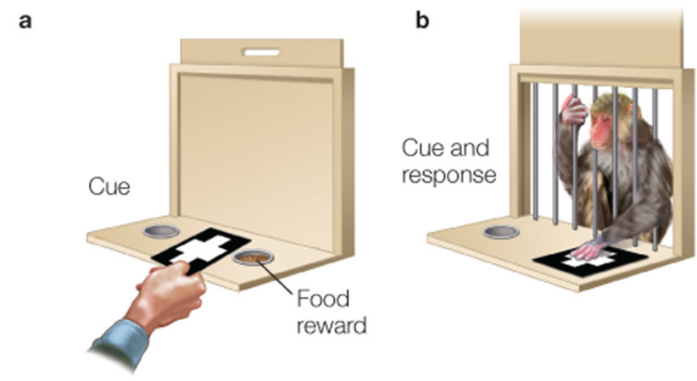
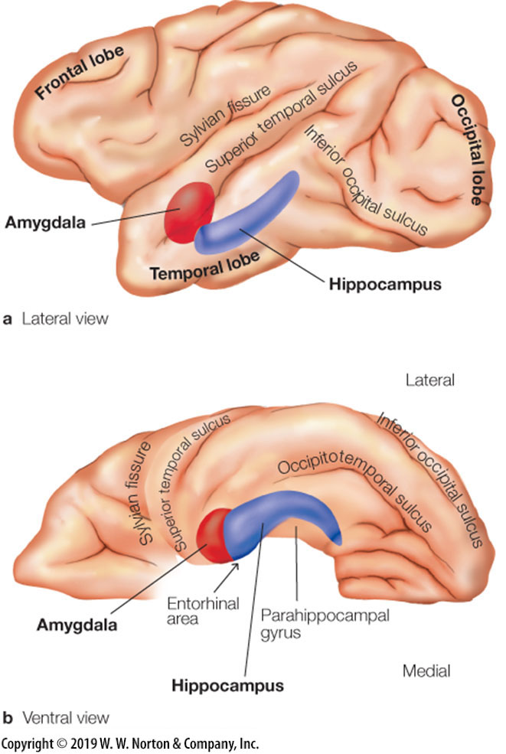
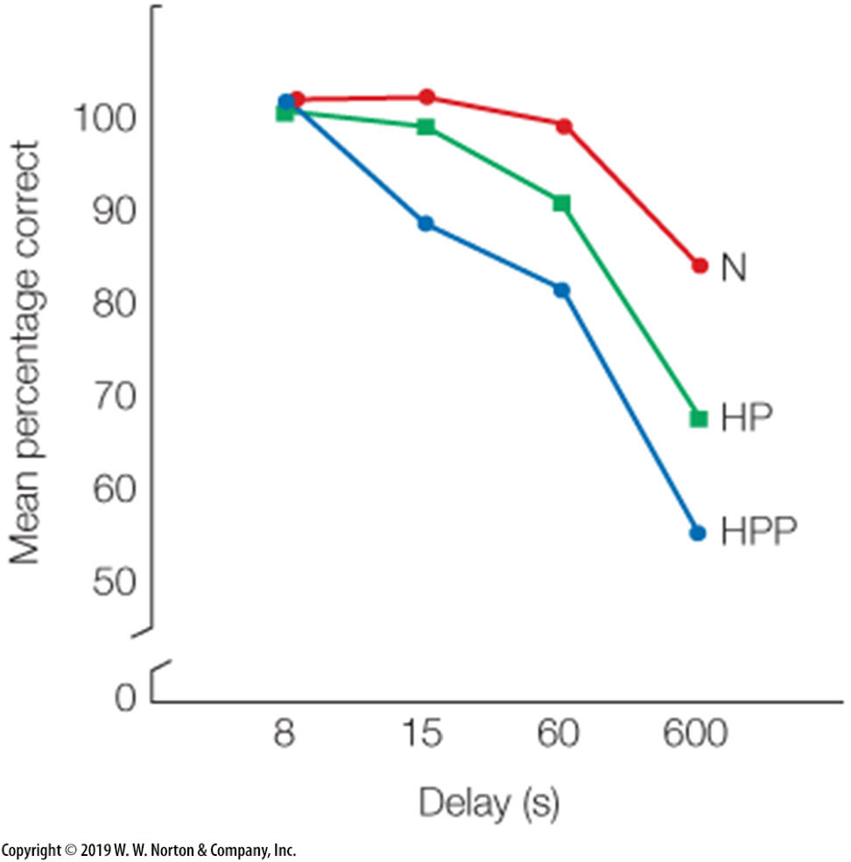
Long-Term Memory
Zola-Morgan et al. (1993)
Research Question: How do different components of the medial temporal lobe contribute to declarative memory?
Methods
Phase 1: Food hidden under object, monkey can pick up object and get food
Phase 2: Two objects are placed, one being the original object, but the food is now placed under the new object
Picking up old object results in no reward
IV:
No lesion (N)
Lesion to hippocampus and parahippocampal cortex (HP)
Lesion to hippocampus, parahippocampal cortex, and perirhinal cortex (HPP)

Slide 30
Long-Term Memory
Zola-Morgan et al. (1993)
DV: Accuracy in selecting the novel object to obtain reward
Results: Memory deficits increase with more regions lesioned
Conclusion: Hippocampus + surrounding regions also involved in memory formation
Not only is the hippocampus necessary, but the connections it has also impairs memory. So, it’s a network

Slide 31
Lecture Outline
Learning
Working Memory
Long-Term Memory
Memory Storage

Slide 32

Memory Storage
Long-Term Memory Storage
Driven by neuroplasticity: Ability for brain to reorganize structural and functional connections
Long-Term Potentiation/Depression (LTP/LTD): The strengthening/weakening of synaptic efficiency
Changes in the release of presynaptic neurotransmitters
Changes in the number/sensitivity of postsynaptic receptors
Synaptogenesis
Formation of new useful synapses
Pruning of non-useful synapses
Reorganization of non-useful synapses into useful synapses
Glial Plasticity: Changes in the number and function of glial cells
Adult Neurogenesis: Formation of new neurons and connections

Slide 33
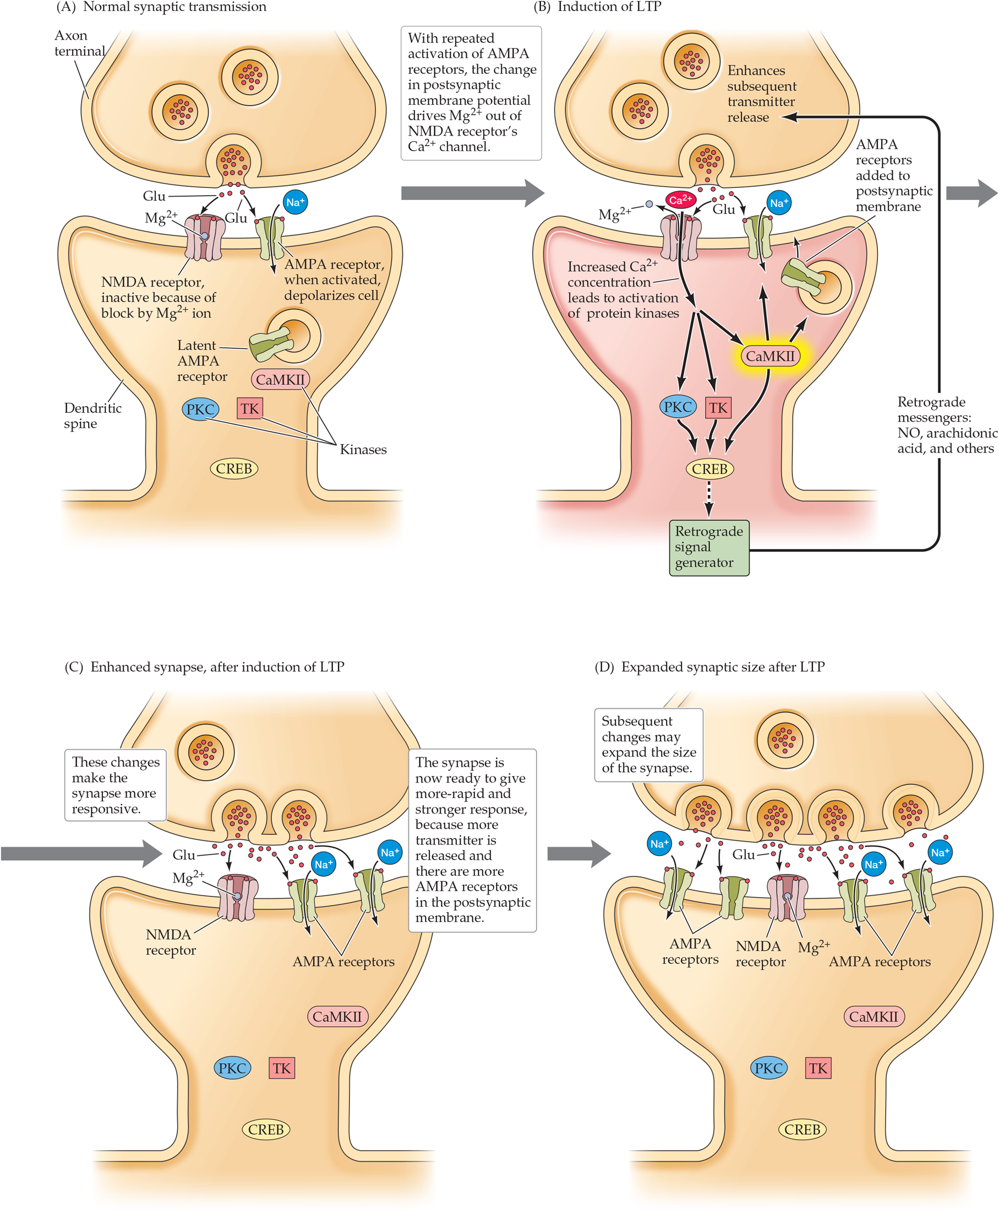
Memory Storage
Long-Term Potentiation Mechanisms
Interaction of Glutamate, NMDA, and AMPA
Glutamate: Excitatory neurotransmitter
AMPA Receptor: Glutamate receptor that allows Na⁺
NMDA Receptor: Glutamate receptor that allows Ca²⁺

Slide 34
Memory Storage
Long-Term Potentiation Mechanisms
Interaction of Glutamate, NMDA, and AMPA
Low-Levels of Communication:
Glutamate activates AMPA receptors (influx of Na⁺)
NMDA receptors blocked by magnesium ions (Mg²⁺)
High-Levels of Communication:
Increased activation of AMPA receptors (influx of Na⁺)
If depolarization from AMPA reaches -35 mV, Mg²⁺ released from NMDA receptors
Glutamate activates NMDA (influx of Ca²⁺)
Increases number of AMPA receptors and ionic sensitivity
Retrograde messenger (diffusible gas) travels back to presynaptic cell to increase glutamate release

Slide 35
Memory Storage

Slide 36
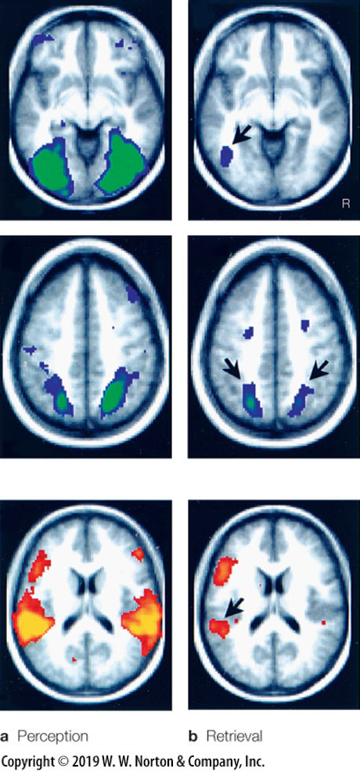
Memory Storage
Wheeler et al. (2000)
Research Question: Where are memories stored?
Task: Participants learned a set of sounds or pictures, each with a written label of the item (e.g., bell). Participants were then given perceptual and memory tests with fMRI
Manipulation:
Perceptual Test: Items once again presented as just described
Memory Retrieval Test: The written label was presented and participants were to indicate whether the item was associated with a sound or a picture

Slide 37
Memory Storage
Wheeler et al. (2000)
Results: Association (secondary) cortices specific to respective modality re-activated in subsets of the regions activated during perception
Conclusion: Memory is stored and retrieved by reactivating perceptual networks

Slide 38

Testable Figures
Slide 8
Slide 20
Slide 35
All figures corresponding to the results of a study are testable material.

